Slide 1
Predicting air temperature using multiple linear regression: a case study of McGill
INFS 630 - DATA MINING
FINAL PROJECT PRESENTATION
GROUP 10
Priyadharshini Sakthivel (261098987) priyadharshini.sakthivel@mail.mcgill.ca | Vaishali Mishra (261069994) vaishali.mishra@mail.mcgill.ca

Slide 2
Urban Climate
Climate change - global issue - urban activities - significant contributors to greenhouse gas emissions
Urbanization - increase in exposure to consequences of climate change - most studies focus on global macroclimate - very few on urban microclimates

Slide 3
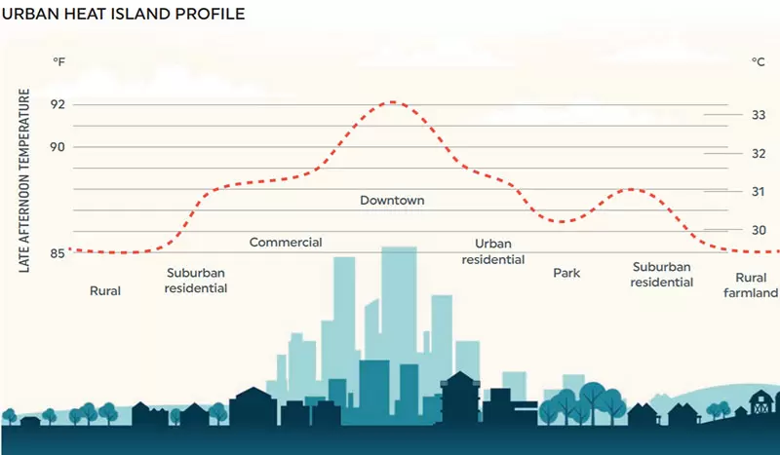
Purpose of the project
Urban climate - ‘Urban Heat Island’ - urban areas experience a higher temperature relative to their rural surroundings
Focus should be on climate adaptation - green infrastructure.
Predict temperature if time and vegetation cover percentage are given.
https://fect.lk/urban-heat-islands/2021/10/01/

Slide 4
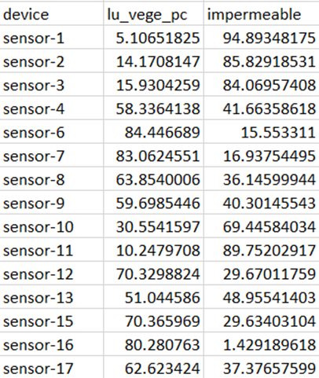
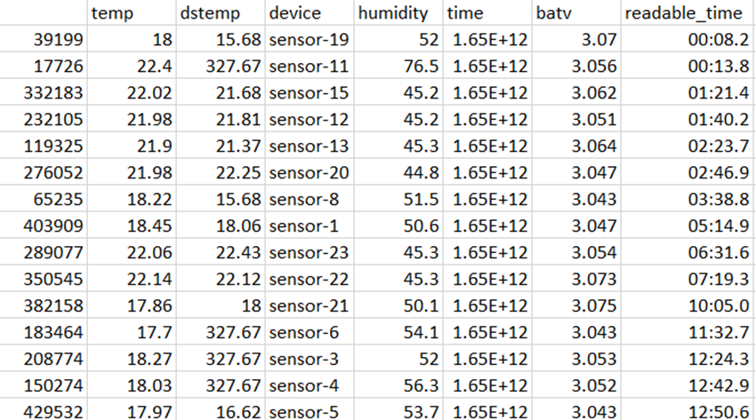
Data
File 1 - vegetation cover percentage
File 2 - temperature measurements
Collected under the supervision of Prof. Raja Sengupta, Bieler school of environment by Alexander Liam

Slide 5
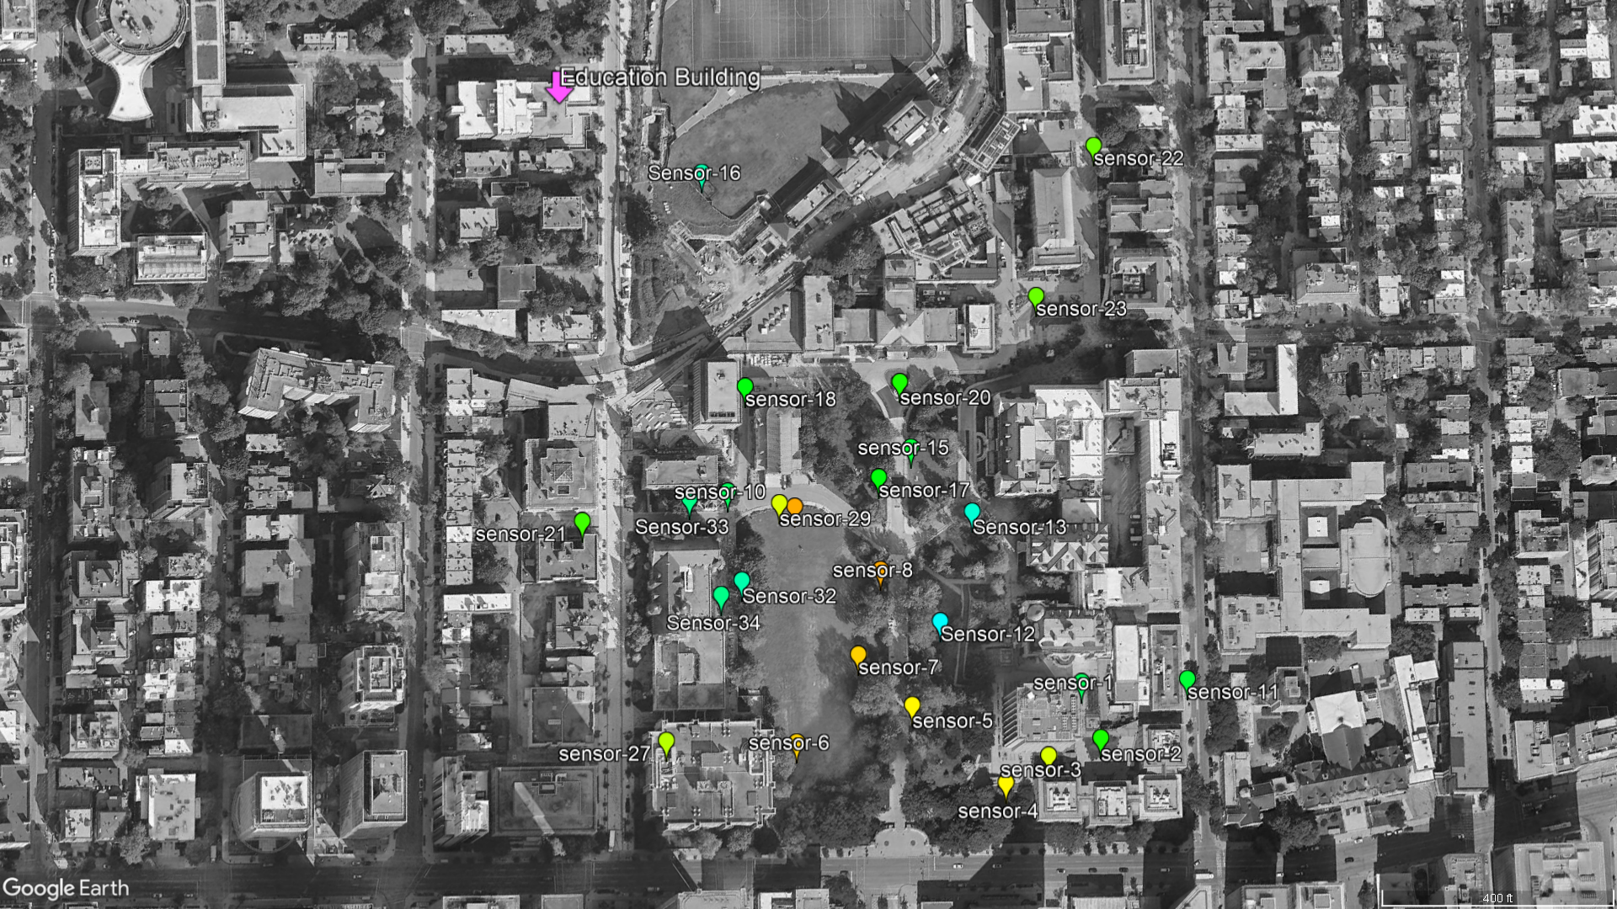
Sensor distribution across McGill

Slide 6
Methodology
Data cleaning and preparation
Splitting data into seasons
Multiple Linear Regression modelling - I
Multiple Linear regression modelling - II
Accuracy assessment

Slide 7
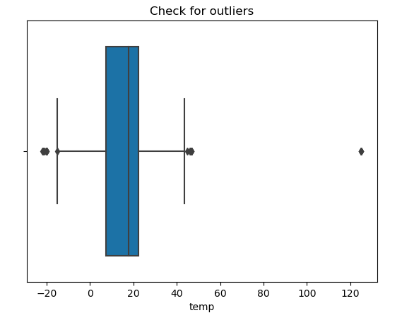
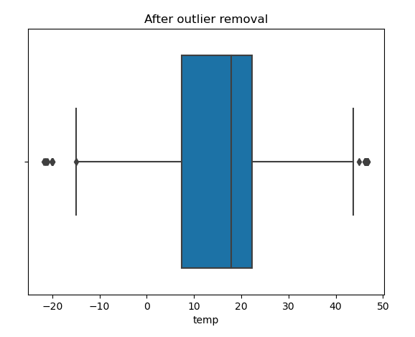
Methodology (Data cleaning and preparation)
Used pandas and matplotlib.
Dropping unwanted columns like the ‘impermeable’ column in File 1 and ‘dstemp’, ‘device’, ‘time’ and ‘batv’ from File 2.
Checking for outlier values in the ‘temp’ column through a box plot and removing those outliers which were due to ‘impossible’ values.

Slide 8
Methodology (Data cleaning and preparation)
Merged the two CSV files on the ‘device’ column, and checked for null values. No null values due to the ‘inner’ join between the tables.
Removing malfunctioning sensors after plotting graphs for the variation of the temperature over the year by sensor number. Sensors 7 and 13 were removed through this process.
Creating a column for ‘unix_time’ from ‘readable_time’ as the linear regression model does not accept a datetime variable.
Unix time measures time by the number of seconds that have elapsed since June 1, 1970.

Slide 9
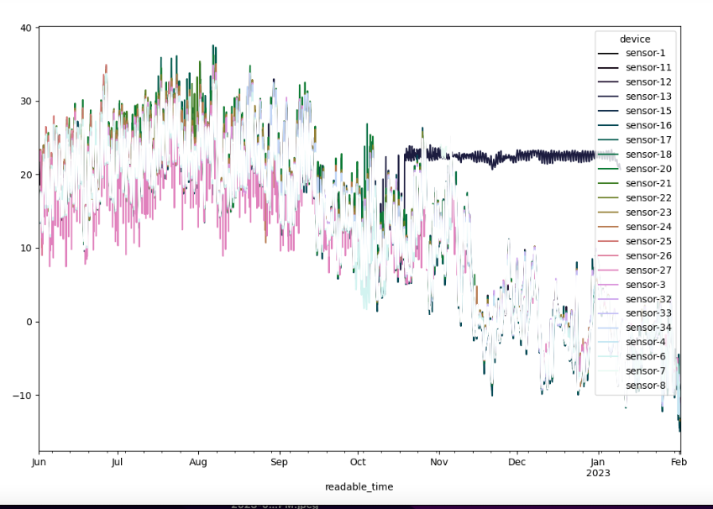
Plot for temperature variation over time by sensors (Before removing malfunctioning sensors)

Slide 10
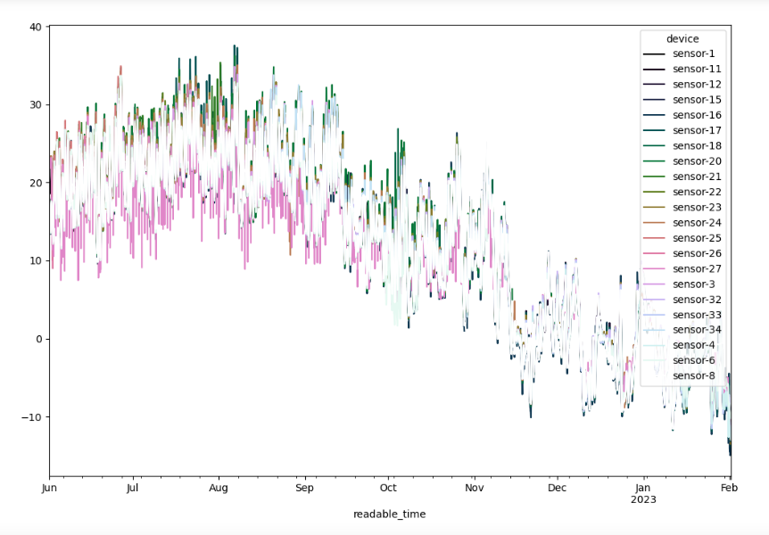
Plot for temperature variation over time by sensors (After removal of malfunctioning sensors)

Slide 11
Methodology (Building a linear regression model for entire dataframe)
What is Regression Analysis?
Linear regression is a popular method used for numeric prediction for dependent variable on the basis of the independent variables.
It assumes a linear relationship between the variables.
Simple Linear Regression: Y = m.x + c
Multiple Linear Regression with two predictor variables:
Y = m₁x₁ + m₂x₂ + c
We used TimeSeriesSplit from the scikit-learn library in Python to split training and testing data based on a time variable.
Finally, we used LinearRegression from scikit-learn to build the model based on the training and testing datasets.

Slide 12
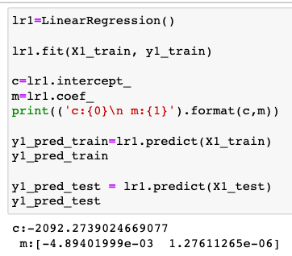
Methodology (Building a linear regression model for seasonal slices)
Due to the lack of data for an effective TimeSeriesSplit, we created seasonal slices of the dataframe by creating a month column and slicing based on that i.e three dataframes for summer, fall, and winter.
Then, the same linear regression model was run for these three seasonal dataframes to check the difference in results from that of the whole dataframe.

Slide 13
Results and discussion
Table showing the R² score and RMSE values for the training and testing datasets of the whole dataframe, and the seasonal dataframes.
R² score measures the goodness of the fit of the model. It ranges between 0 and 1. But, the values can also be negative if the model fits the data very poorly.
The RMSE values measures the accuracy of the model. Ideally, it should be as close to zero as possible.
 | 9 MONTHS |  | SUMMER |  | FALL |  | WINTER
 | r-squared | rmse | r-squared | rmse | r-squared | rmse | r-squared | rmse
Train | 0.41 | 5.44 | 0.21 | 4.57 | 0.28 | 3.84 | 0.014 | 4.46
Test | -2.8 | 8.85 | -1.29 | 5.91 | 0.26 | 6.07 | -0.34 | 4.07

Slide 14
Results and discussion
Low accuracy measures - climate is temporally autocorrelated, i.e. two observations that are close to each other in time are similar in measurement - smaller dataset - used summer and fall to predict winter,
Vegetation did not have much significance.
Large dataset across longer time period and considering additional factors might improve accuracy
Another approach - making temperature ordinal or nominal - non-parametric methods like decision tree, k-NN

Slide 15
Thank you

Slide 16
References
Bazrkar, M. H., Zamani, N., Eslamian, S., Eslamian, A., & Dehghan, Z. (2015). Urbanization and Climate Change. In W. Leal Filho (Ed.), Handbook of Climate Change Adaptation (pp. 619–655). Springer. https://doi.org/10.1007/978-3-642-38670-1_90
Erell, E. (2008). The Application of Urban Climate Research in the Design of Cities. Advances in Building Energy Research, 2, 95–121. https://doi.org/10.3763/aber.2008.0204
UNDESA. (2018). https://www.un.org/development/desa/en/news/population/2018-revision-of-world-urbanization-prospects.html
UNEP. (2017, September 26). Cities and climate change. UNEP - UN Environment Programme. http://www.unep.org/explore-topics/resource-efficiency/what-we-do/cities/cities-and-climate-change
Webb, B. (2016). The use of urban climatology in local climate change strategies: A comparative perspective. International Planning Studies, 22, 1–17. https://doi.org/10.1080/13563475.2016.1169916
Yang, X., Peng, L. L. H., Jiang, Z., Chen, Y., Yao, L., He, Y., & Xu, T. (2020). Impact of urban heat island on energy demand in buildings: Local climate zones in Nanjing. Applied Energy, 260, 114279. https://doi.org/10.1016/j.apenergy.2019.114279
Zhou, D., Xiao, J., Bonafoni, S., Berger, C., Deilami, K., Zhou, Y., Frolking, S., Yao, R., Qiao, Z., & Sobrino, J. A. (2019). Satellite Remote Sensing of Surface Urban Heat Islands: Progress, Challenges, and Perspectives. Remote Sensing, 11(1), Article 1. https://doi.org/10.3390/rs11010048

